Slide 1


Review: Multiple Linear Regression
Wake Forest
School of Business
_______
BAN 6025

Slide 2
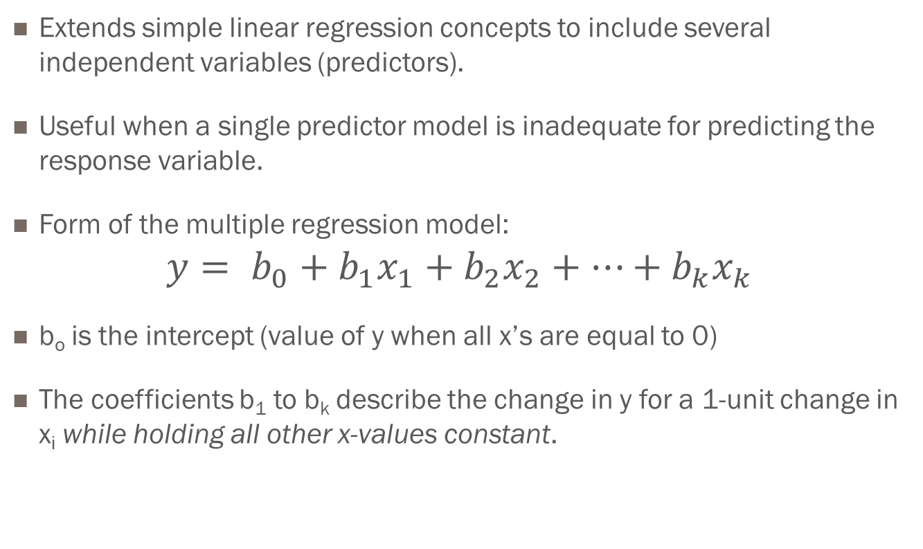
Multiple Linear Regression Models
Extends simple linear regression concepts to include several independent variables (predictors).
Useful when a single predictor model is inadequate for predicting the response variable.
Form of the multiple regression model:
$$y= b_{0}+b_{1}x_{1}+b_{2}x_{2}+⋯+b_{k}x_{k}$$
b_{o} is the intercept (value of y when all x’s are equal to 0)
The coefficients b₁ to b_{k} describe the change in y for a 1-unit change in x_{i} while holding all other x-values constant.

Slide 3

Regression Modeling Process
Building multiple linear regression models is a highly iterative process.
It is as much art as it is science.
It requires an understanding of both the business context and the statistical method.
There is no absolute right or wrong model.
“Essentially, all models are wrong, but some are useful.” - George E. P. Box

Slide 4
What is an interaction?
An interaction term is present when the effect of one of the explanatory variables on the response variable depends in some way on a second variable.
In other words, if there is an interaction between variables x1 and x2, the change in y for a 1 unit change in x1 will be different at different levels of x2.

Slide 5
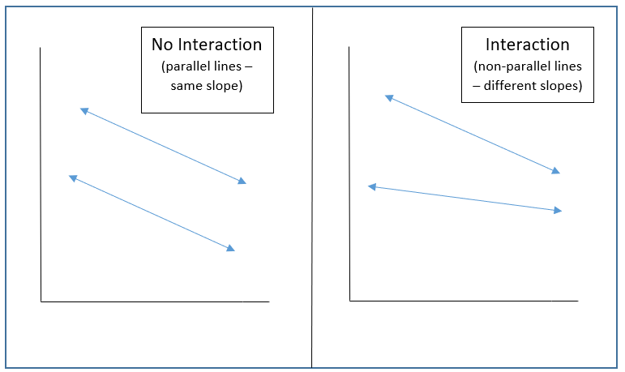
Interactions (continued)

Slide 6
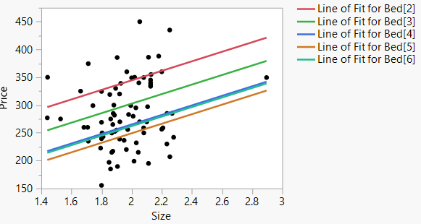
Example: Housing Data
No interaction between Number of Bedrooms and Size of the House

Slide 7
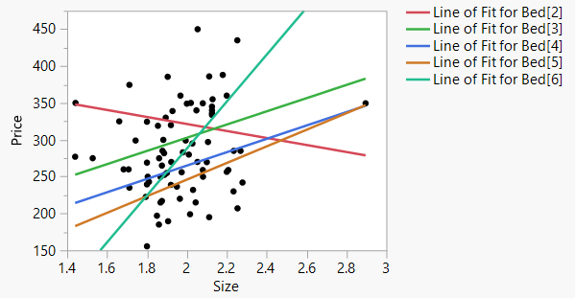
Example: Housing Data
Interaction between Number of Bedrooms and Size of the House

Slide 8
Polynomial Terms
If the relationship between the response variable and the explanatory variable exhibits a quadratic or cubic (or other higher order) relationship rather than a linear relationship, higher order terms can be added to the model to account for that curvature.
If the curvature is not recognized during the exploratory phase of the analysis, it will often be revealed during the post-hoc analysis of the residuals.

Slide 9
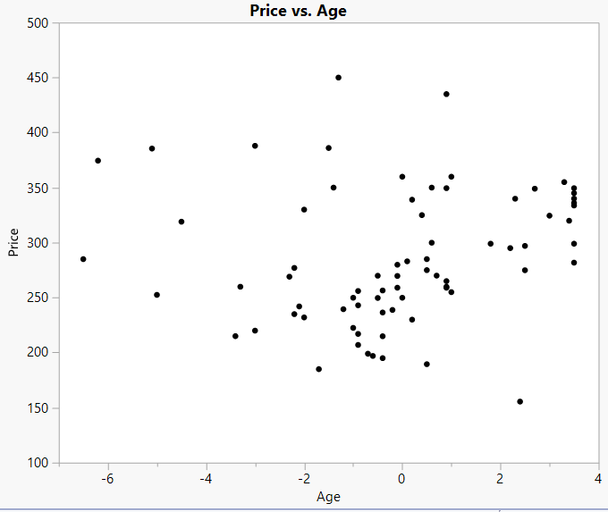
Example: Housing Data

Slide 10
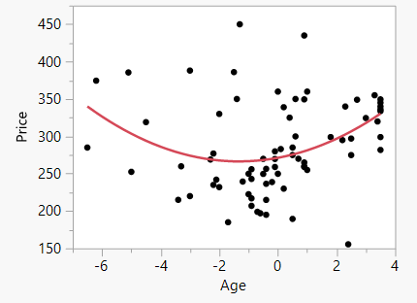
Example: Housing Data

Slide 11
Regression Modeling Process
Begin by examining pairwise relationships between the response and each explanatory variable
Scatterplots, correlations
Select initial subset to begin building model
Systematically add and remove explanatory variables from the model
“by hand” or using automatic techniques (forward, backward, stepwise)
Examine the residual plots to look for potential violations of the regression assumptions

Slide 12
Regression Modeling Process
To check for normality
Histogram of residuals
Normal quantile (Q-Q) plot
Use transformation such as log or square root to address non-normality
To check for heteroskedasticity
Scatterplot of residuals vs predicted values or residuals vs individual x-variable
Use transformation such as log or square root to address heteroskedasticity
Multicollinearity
Look for instability in coefficients (sign, significance), correlation between x-variables, high VIF
Remove one of the correlated variables from the model

Slide 13
Regression Modeling Process
To check for independent errors
Scatterplot of residuals vs predicted values
Add lagged values of the response variable to the model
Nonlinearity
Add polynomial terms to the model
Outliers
Investigate and determine whether the values are legitimate data values
Determine whether the outlier is influential
Transformations such as log or square root can also reduce the effect of outliers
Consider adding other derived variables (such as interaction terms) to the model
Determine how to treat missing values

